Slide 1
Heterogeneous Computing : Elementary Notions
Lecture
CS1
Fall 2018

Slide 3

von Neumann Architecture
What’s a Computer?
Computer

Slide 4
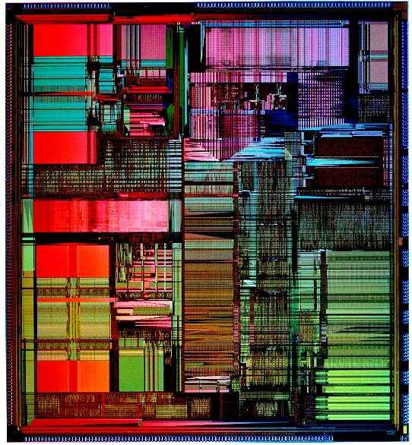
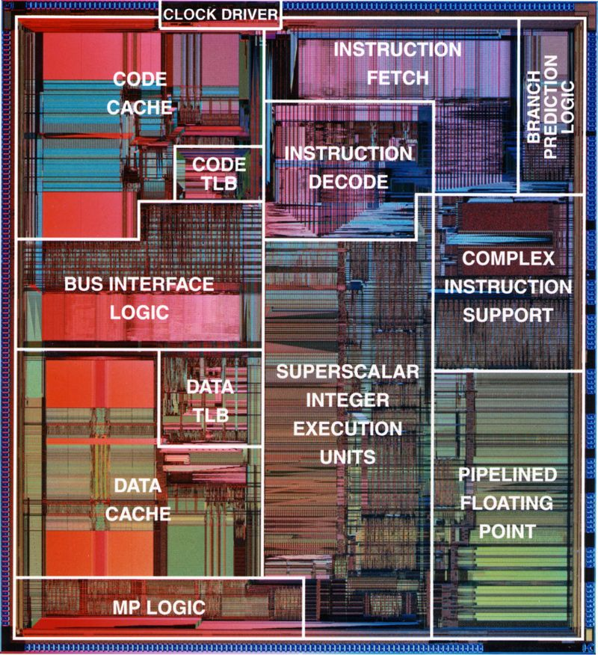

Inside a Processor

Slide 5
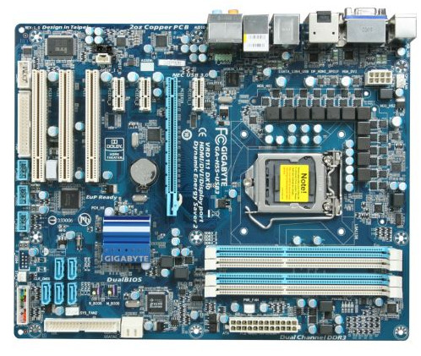

Processor on a Board

Slide 6

Processor on a Board

Slide 7
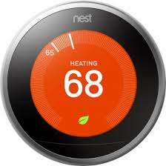
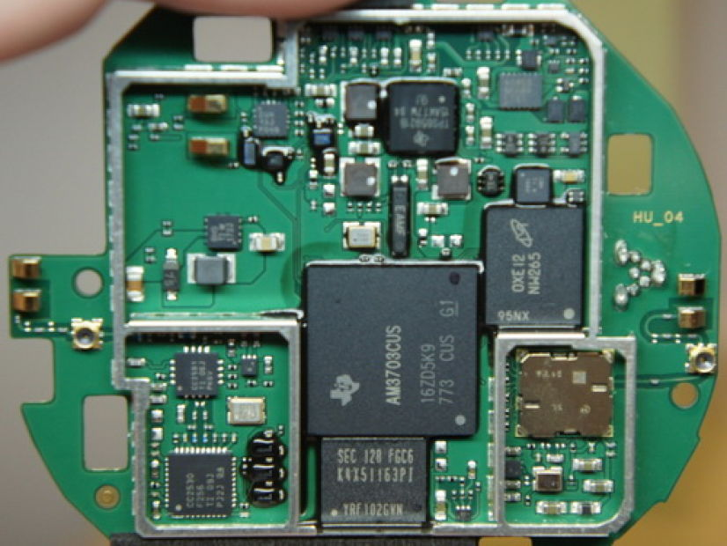
Processor on a Board

Slide 8
Inside a Processor

Slide 9
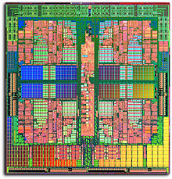
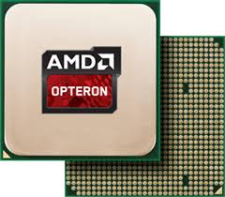
The Multicore Processor

Slide 10
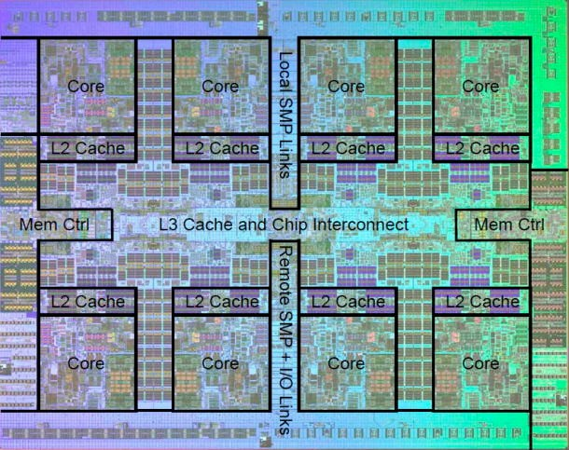
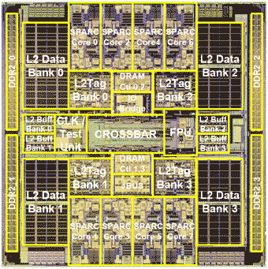
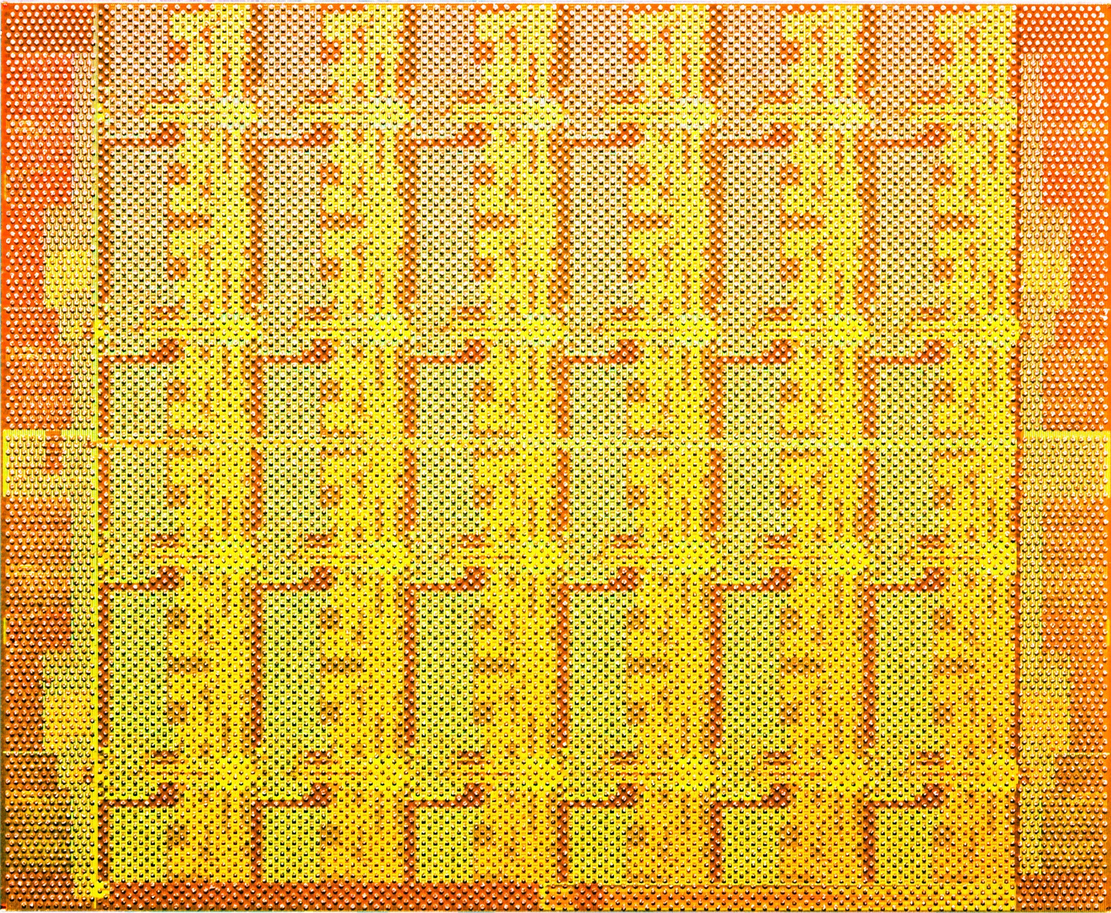
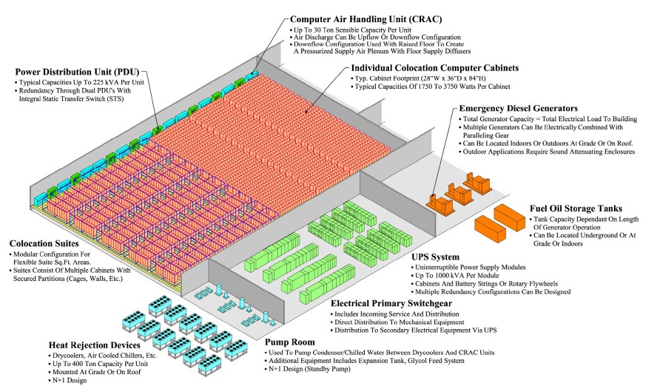





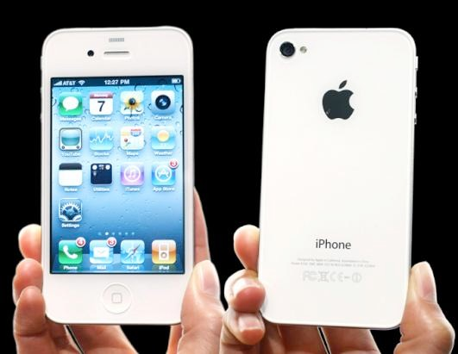
The Multicore Era

Slide 11
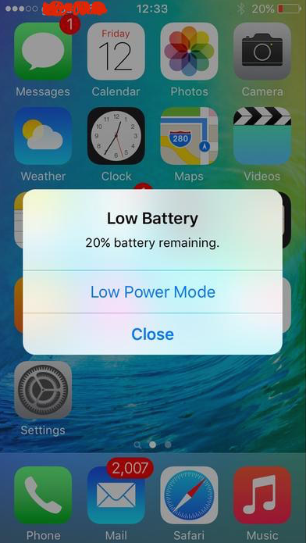
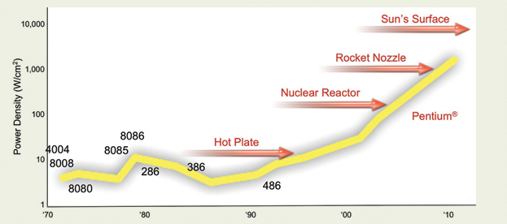
Computing is not just about performance
Chart courtesy : Pat Gelsinger, Intel Developer Forum, 2004

Slide 12
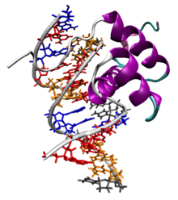
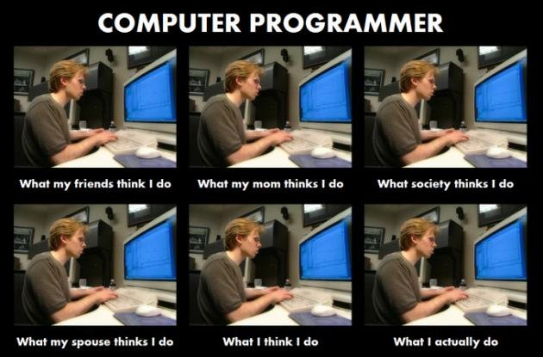

Program Execution
.text
.globl _main
_main:
LFB2:
pushq %rbp
LCFI0:
movq %rsp, %rbp
LCFI1:
movl $17, -4(%rbp)
movl $13, -8(%rbp)
movl -8(%rbp), %eax
addl -4(%rbp), %eax
movl %eax, -12(%rbp)
movl -12(%rbp), %eax
leave
ret
Tuning Level
compile
execute
…11001010100…
code
int main() {
int x, y, result;
x = 17;
y = 13;
result = x + y;
return result;
}
Notes:
12

Slide 13
Program Execution
11001010100
x = 17;
time
Tuning Level
11001110101
y = 13;
DONE!
int main() {
int x, y, result;
x = 17;
y = 13;
result = x + y;
return result;
}
code
00001010100
result = x + y;
compile
10101010100
return result;
Instruction execution follows program order
Processor executes one instruction at a time*
Notes:
13

Slide 14
Parallel
Program Execution
x = 17;
time
Tuning Level
y = 13;
DONE!
int main() {
int x, y, result;
x = 17;
y = 13;
result = x + y;
return result;
}
code
result = x + y;
compile
return result;
The two assignment statements
x = 17; and y = 13; will execute in parallel
Notes:
14

Slide 15
Parallel
Program Execution
int main() {
int x, y, result;
x = 17;
y = 13;
result = x + y;
return result;
}
y = 13;
x = 17;
time
y = 13;
x = 17;
result = x + y;
result = x + y;
Cannot arbitrarily assign instructions to processors
return result;
return result;
Notes:
15

Slide 16
Dependencies in Parallel Code
If statement s_{i} needs the value produced by statement s_{j} then, s_{i} is said to be dependent on s_{j}
All dependencies in the program must be preserved
This means that if s_{i} is dependent on s_{j} then we need to ensure that s_{j} completes execution before s_{i}
s_{j}
y = 17;
...
...
x = y + foo();
s_{i}
responsibility lies with programmer (and software)

Slide 17
Parallel Performance
Potential program speedup is defined by the fraction of code that can be parallelized
Use 4 processors for parallel work
25 seconds
+
sequential
time
25 seconds
+
sequential
40 seconds
+
parallel segment
10 seconds
+
25 seconds
sequential
25 seconds
sequential
90 seconds
60 seconds

Slide 18
Parallel Performance
Potential program speedup is defined by the fraction of code that can be parallelized
What if we had 10 processors?
What if 100, 1000?
25 seconds
+
sequential
time
25 seconds
+
sequential
40 seconds
+
parallel
10 seconds
+
25 seconds
sequential
25 seconds
sequential
90 seconds
60 seconds
Speedup = old running time / new running time
= 90 seconds / 60 seconds
= 1.5

Slide 19
Parallel Performance
In the ideal case, the more processors we add to the system the higher the performance speedup
If a sequential program runs in T seconds on one processor then the parallel program should run in T/N seconds on N processors
In reality this almost never happens. Almost all parallel programs will have some parts that must run sequentially

Slide 20

Amdahl’s Law
Gene Amdahl
IBM
Amount of speedup obtained is limited by the amount of parallelism available in the program

Slide 21
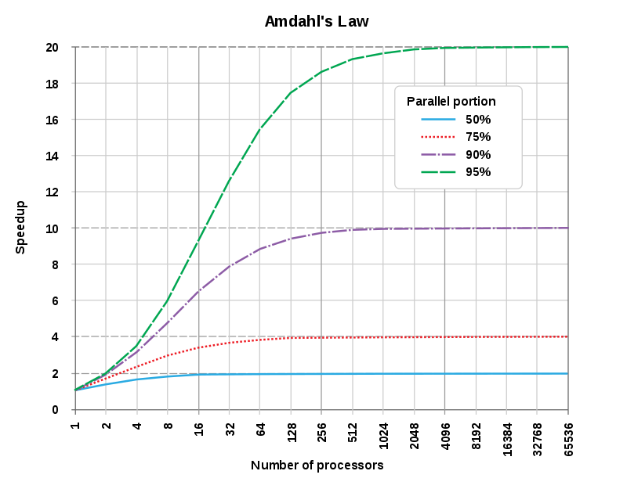
Amdahl’s Law and Scalability

Slide 22
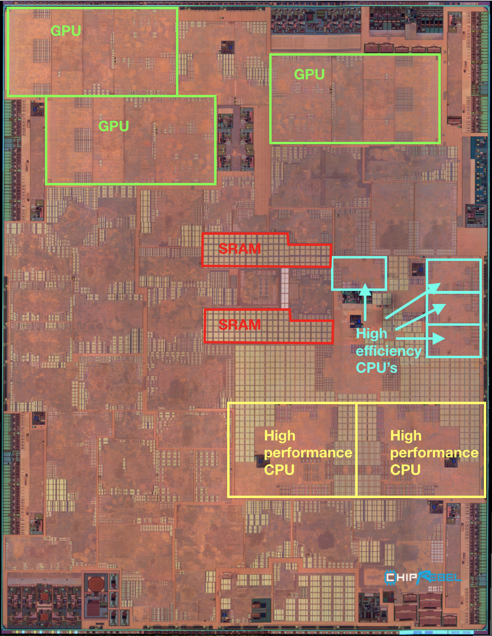
Heterogenous Processors
Notes:
Why do we want to have different kinds of processors on a phone?
What is your typical usage? What apps do you have running on your phone?
Can someone share the apps they currently have running (in the background)?
Introduce the notion of a workload.
A bunch of apps with different characteristics and different demands for resources.

Slide 23
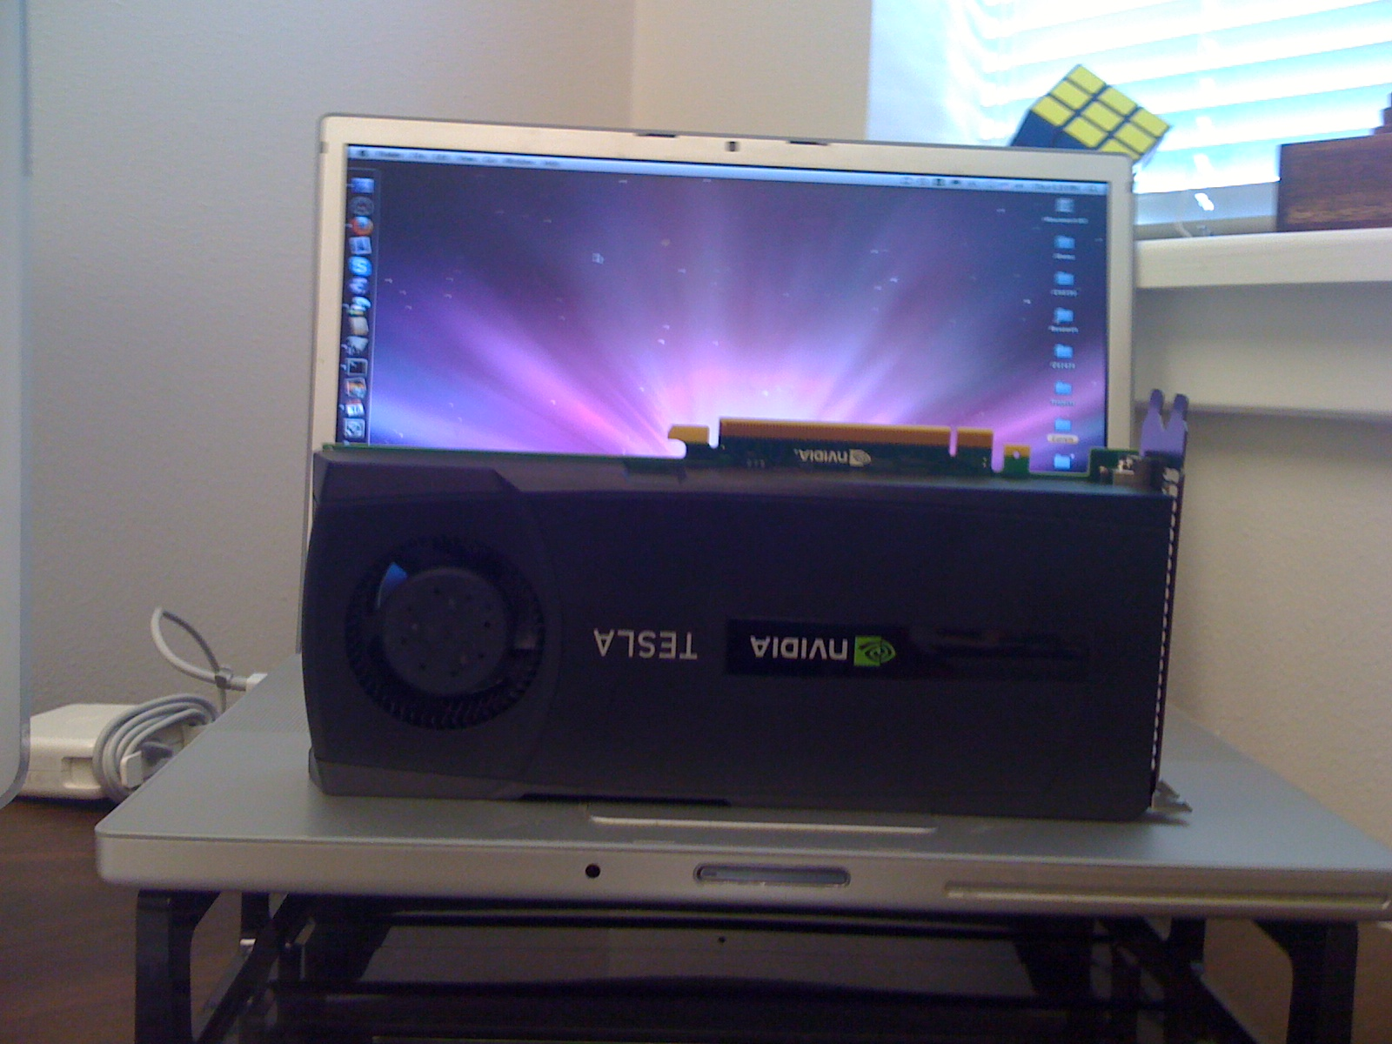
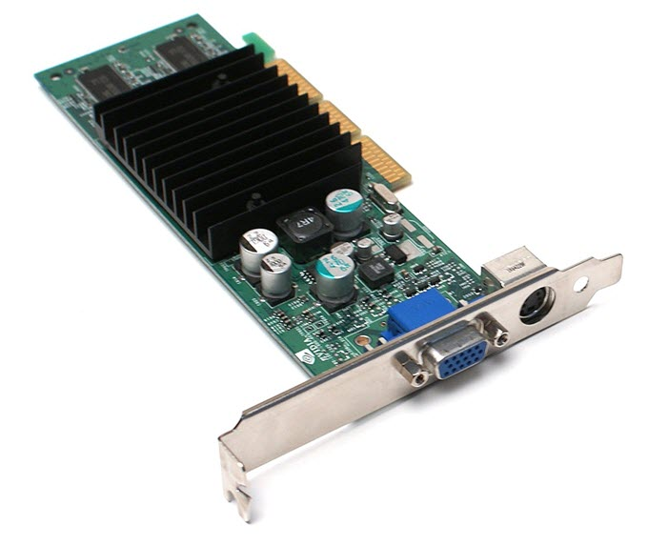
GPUs

Slide 24
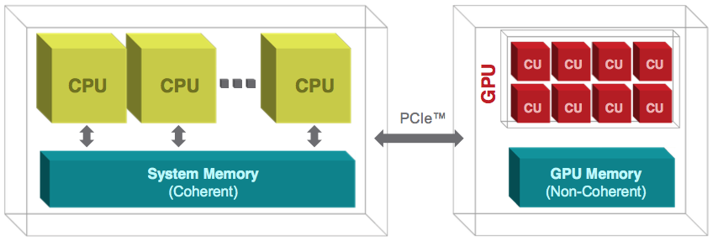
CPU + GPU Heterogeneity

Slide 25
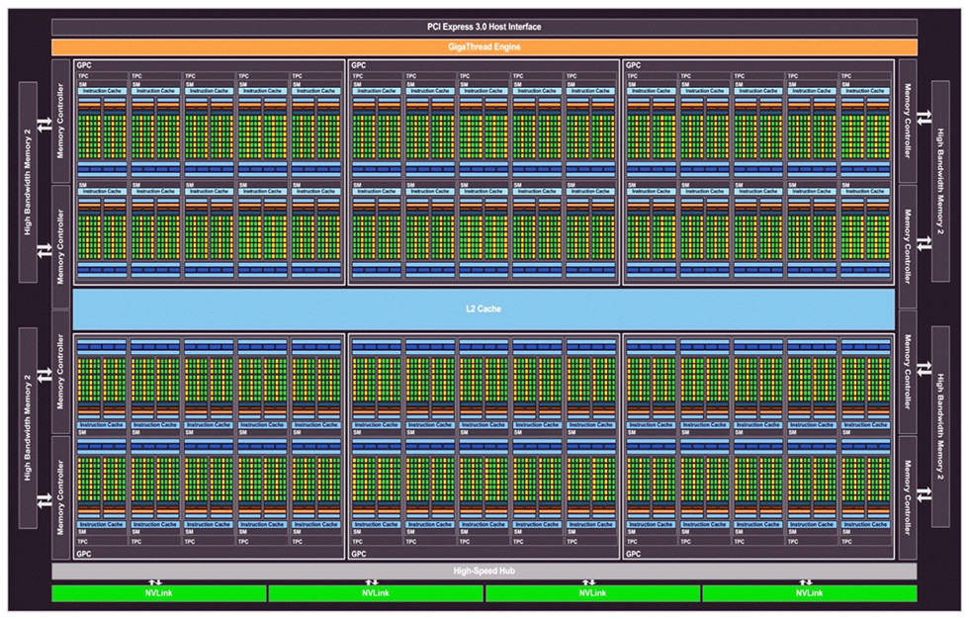
NVIDIA Pascal
Scale
number of cores/SM
number of SMs/GPU

Slide 26

Soft Heterogeneity
Heterogenous Multicore System
Operational frequency is different
Notes:
Introduce notion of clock frequency and it’s impact on performance (CS1 students will generally know this)
What is your consideration when buying a new laptop?
lead discussion towards processing speed/ clock rate
Why do you care about clock rate?
Processors can operate at frequencies other than the one advertised.
Any one familiar with the term overclocking?
we expect some CS1 students to be already familiar with at at least the term
Similarly, we can also “underclock” a processor
Why might we want to run a processor at lower frequency?
Alternatively, why not overclock all the time?

Slide 27
Parallel
Program Execution
x = 17;
time
Tuning Level
y = 13;
DONE!
int main() {
int x, y, result;
x = 17;
y = 13;
result = x + y;
return result;
}
code
result = x + y;
compile
return result;
The two assignment statements
x = 17; and y = 13; will execute in parallel
Notes:
27

Slide 28
Parallel
Program Execution
x = 17;
time
Tuning Level
y = sqrt(z);
DONE!
int dostuff(int z) {
int x, y, result;
x = 17;
y = sqrt(z);
result = x + y;
return result;
}
code
result = x + y;
compile
return result;
“Big” processor is twice as fast
Notes:
28

Slide 29
Program Execution
Heterogeneous
x = 17;
time
int dostuff(int z) {
int x, y, result;
x = 17;
y = sqrt(z);
result = x + y;
return result;
}
y = sqrt(z);
Tuning Level
DONE!
result = x + y;
return result;
Assign heavier computation to the “bigger” processor
Notes:
29

Slide 30



Heterogenous Programming Tools
Heterogeneous programming is typically in programming languages that provide support for parallelism
Languages provide extensions in the form APIs that allow us to program heterogenous systems
For example, CUDA is a C/C++ extension for programming GPUs built by NVIDIA
So, no need to learn a new language!

Slide 31
Back-up Slides

Slide 32
Parallel Quicksort
int quickSort(int values[], int left, int right) {
if (left < right) {
int pivot = (left + right)/2;
int pivotNew = partition(values, left, right, pivot);
quickSort(values, left, pivotNew - 1);
quickSort(values, pivotNew + 1, right);
}
}
...partition()...
quickSort(values, left, pivotNew - 1);
quickSort(values, pivotNew + 1, right);
To get benefit from parallelism want to run “big chunks” of code in parallel
Also need to balance the load
Notes:
32

Slide 33
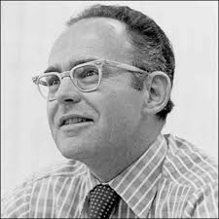
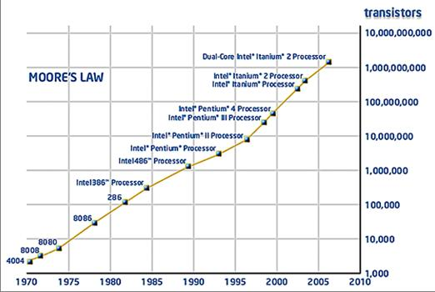
Moore’s Law
Processor Speed
Gordon Moore
Intel
Published in 1965 in Electronics

Slide 34
The Multicore Shift
longer issue pipeline
double speed arithmetic
Full Speed Level 2 Cache
more responsibility on software
must exploit parallelism
instruction pipeline
16 MHz
25 MHz

